Slide 1
Low-cost deadlock avoidance in direct interconnection networks
Enrique Vallejo
http://personales.unican.es/vallejoe/
Invited talk
9th International Workshop on
Interconnection Network Architecture:
On-Chip, Multi-Chip (INA-OCMC) 2015

Slide 2
Index
Introduction
Direct interconnection network topologies: low radix
Deadlock avoidance mechanisms
Topologies proposed for high-radix networks
Dragonfly networks
Topology and routing
OFAR: Injection restriction
RLM: Path restriction
OLM: Modified Resource-class restriction
Evaluation results
Conclusions

Slide 3
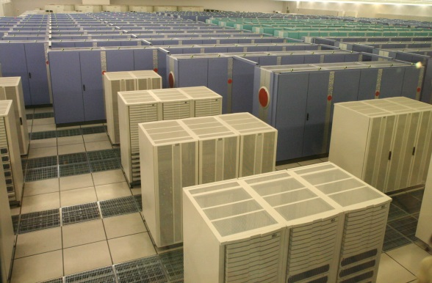
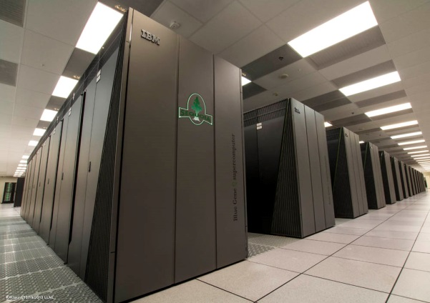
1. Introduction 1.1 Direct Interconnection network topologies
Direct topology: no transit routers, all routers have computing nodes directly attached.
Previous trends on direct interconnection network Architectures: Low radix, high diameter
Hypercubes
2D/3D Meshes & Tori
Earth simulator
Cray: T3D, T3E, XT3-4-5, XK6-7
BlueGene /L /P
5D Tori
BlueGene /Q
Tofu (K computer)

Slide 4
1. Introduction 1.2 Deadlock avoidance mechanisms
HPC interconnection networks are usually lossless & deadlock-free.
The deadlock freedom mechanism employed depends on
Topology, and
Routing mechanism
It impacts router design & cost: #VCs, buffer area, allocation, etc.
Deadlock-free routing implemented via restrictions:
Path restrictions: Cycles never appear on the network
Dimension-Ordered Routing (DOR)
Turn model [1], O1Turn [2]
Resource-class restrictions: Impose a fixed order for VCs
Distance classes (per-hop increasing order) [3] – relatively high cost!
Datelines [4]
Injection restriction: Avoid injecting traffic if it could block the network
Bubble routing [5,6]
[1] Glass & Ni, “The turn model for adaptive routing”, ISCA’92
[2] Seo et al. “Near optimal worst-case throughput routing for two-dimensional mesh networks”, ISCA’05
[3] Gunther, “Prevention of deadlocks in packet-switched data transport systems,” Trans. Comm’81.
[4] Dally & Seitz, “The Torus Routing Chip”, J. Distributed Computing 1986
[5] Carrión, et al, “A flow control mechanism to avoid message deadlock in k-ary n-cube networks," HiPC’97.
[6] Puente, Izu, Beivide et al, “The Adaptive Bubble Router”, J. PDC’01.

Slide 5
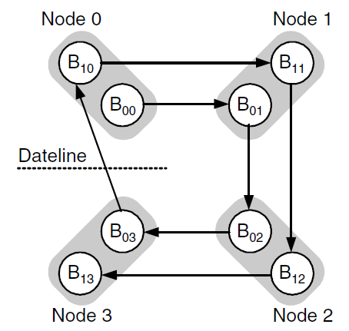
1. 2 Deadlock avoidance in low-radix networks Example: multidimensional torus
Dateline: 2 VCs to avoid cycles
Use example: Cray T3E to XT7
4-ary 2-cube
Figure: Dally & Towles, Principles and Practices of Interconnection Networks”, MK 2003

Slide 6
1. 2 Deadlock avoidance in low-radix networks Example: multidimensional torus
Bubble flow control: Halt injection when it could fill buffers and cause deadlock
Leave at least one slot empty after injection (2 slots required)
Only for virtual cut-through switching (wormhole variants proposed)
Used in IBM BlueGene series (/L, /P, /Q)
injection queue
or
other dimension
X
X
X
X
[5] Carrión, et al, “A flow control mechanism to avoid message deadlock in k-ary n-cube networks," HiPC’97.
[6] Puente, Izu, Beivide et al, “The Adaptive Bubble Router”, J. PDC’01.
VCT
+
Room (local) for 2 packets

Slide 7
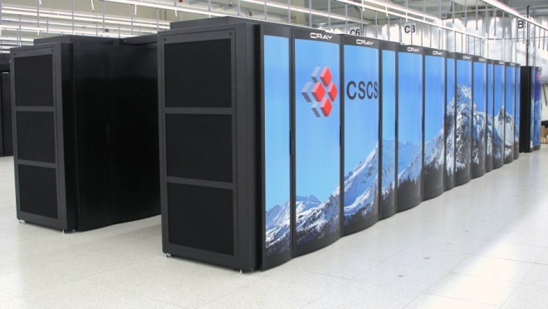
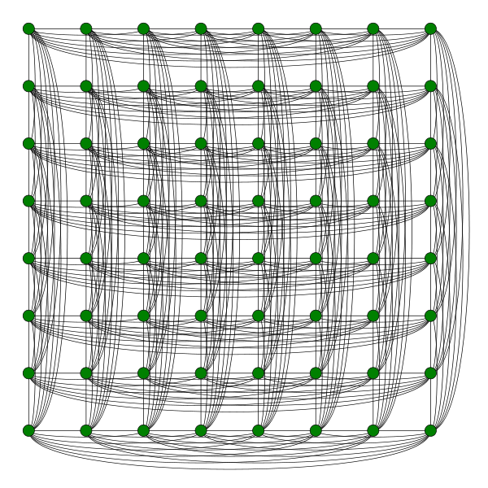
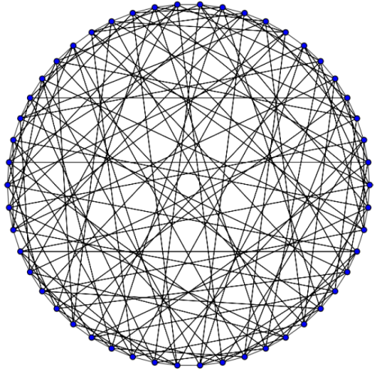
1. Introduction 1.3 Direct Interconnection network topologies
Technological trends suggest [7] the use of high-radix routers
Multiple thin ports rather than few fat ones
High-radix, low diameter direct topologies:
Flattened butterflies [8]
Also: HyperX [9],
based on Hamming graphs
Dragonflies [10]
IBM 775 (PERCS [11], Torrent router)
Cray XC30-40 (Aries router, [12])
Slimflies [13]
Maximum density for a given diameter
…
[7] Kim, Dally, Towles, Gupta, “Microarchitecture of a high-radix router,” ISCA’05
[8] Kim, Dally, Abts, “Flattened butterfly: A cost-efficient topology for high-radix networks”, ISCA’07
[9] Ho Ahn et al, “HyperX: topology, routing, and packaging of efficient large-scale networks”, SC’09
[10] Kim, Dally, Scott, Abts. Technology-Driven, Highly-Scalable Dragonfly Topology. ISCA '08
[11] ] Arimilli et al, “The PERCS high-performance Interconnect”, HOTI’10
[12] Faanes et al, “Cray Cascade: a Scalable HPC System based on a Dragonfly Network,” SC12, [13] Besta & Hoefler, “Slim Fly: A Cost Effective Low-Diameter Network Topology”, SC’14

Slide 8
Index
Introduction
Direct interconnection network topologies: low radix
Deadlock avoidance mechanisms
Topologies proposed for high-radix networks
Dragonfly networks
Topology and routing
OFAR: Injection restriction
RLM: Path restriction
OLM: Modified Resource-class restriction
Evaluation results
Conclusions

Slide 9
2 Dragonfly networks 2.1 Topology and routing
Differences between a traditional datacenter network and a Dragonfly network
Tree
Dragonfly
“pod”
2 main variations:
· Fat-tree: faster links in higher levels
· Folded clos: parallel switches in higher levels

Slide 10
2 Dragonfly netorks 2.1 Topology and routing
Destination group i+N
Minimal Routing
Longest path: 3 hops
local – global – local
Deadlock avoidance:
3 resource classes [3]:
VC0 - VC1 - VC2
2 VCs per local port + 1 VC per global port
Good performance under uniform traffic UN
Saturation of the global link with adversarial traffic ADV+N
[3] K. Gunther, “Prevention of deadlocks in packet-switched data transport systems,” Trans. Communications 1981.
Source group i

Slide 11
2 Dragonfly networks 2.1 Topology and routing
Valiant Routing [10, 14]
Also “global misrouting”
Selects a andom intermediate group
Balances use of links
Doubles latency
Halves max. throughput under Uniform traffic
Longest path 5 hops:
local – global – local – global – local
Deadlock avoidance:
3 VCs per local port + 2 VCs per global port
[10] Kim, Dally, Scott, Abts. Technology-Driven, Highly-Scalable Dragonfly Topology. ISCA '08
[14] L. Valiant, “A scheme for fast parallel communication," SIAM journal on com-
puting, vol. 11, p. 350, 1982.

Slide 12
2 Dragonfly networks 2.1 Topology and routing
Adaptive Routing
Dynamically chooses between minimal and non-minimal routing.
Relies on the information about the state of the network
Source routing → Congested global queues can be in other routers
Piggybacking Routing (PB) [15]
Each router flags if a global queue is congested
Broadcast information about queues
Remote information
Chooses between minimal and Valiant
Source routing
Global
MIN
Global
VAL
Congestion
Router
Router
Busy
Free
Source
SOURCE
GROUP
Router
[15] Jiang, Kim, Dally. Indirect adaptive routing on large scale interconnection networks. ISCA '09. Figure taken from the presentation

Slide 13
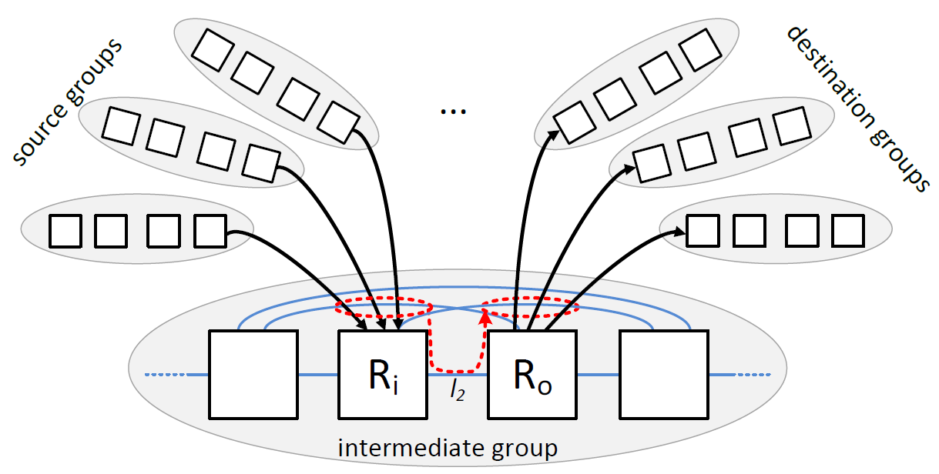
2 Dragonfly networks 2.1 Topology and routing – local misrouting
Saturation of local links can also limit performance [15]
Reduces max. throughput to 1/h. For h=16, Th ≤ 0.0624 phits/c (6,24%)
Occurs with intra-group and inter-group traffic
Near-Neighbor traffic pattern: A single local link connects source and destination node → Saturation
Pathological problem when using Valiant routing with adversarial traffic
[16] García et al, et al, “On-the-fly adaptive routing in high-radix hierarchical networks,” ICPP’12

Slide 14
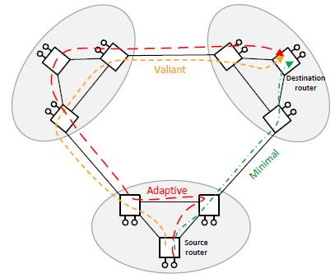
2 Dragonfly networks 2.1 Topology and routing – in-transit misrouting
Minimal local hop
“Local misrouting” avoids saturated local links
Send packets to a different node within the group (non-minimal local hop), then to the destination (minimal local hop)
Longest path: 8 hops
local – local – global – local – local – global – local – local
Distance-based deadlock avoidance (PAR-6/2): 6 VCs per local port + 2 VCs per global port
Protocol-deadlock doubles these requirements (12/4 VCs)
base mechanism with resource classes, too costly!
Non-minimal local hop

Slide 15
2 Dragonfly networks 2.2 OFAR: Injection restriction
OFAR: On-the-Fly Adaptive Routing [16-18]
Deadlock-free escape subnetwork based on injection restriction (bubble)
Fully adaptive without VCs, but lots of “cons”:
Congestion-prone
Theoretically unbounded path lengths
[16] M. García et al, “On-the-fly adaptive routing in high-radix hierarchical networks,” ICPP’12
[17] M. García et al, “OFAR-CM: Efficient Dragonfly Networks with Simple Congestion Management”, HOTI’13
[18] M. García et al, “On-the-Fly Adaptive Routing for dragonfly interconnection networks”, J. Supercomputing’14

Slide 16
2 Dragonfly networks 2.3 RLM Restricted Local Misrouting - Path restriction
Restricted Local Misrouting (RLM) [19] implements adaptive routing with local misrouting using 3/2 VCs (local/global).
Key idea or RLM:
Use the same VC index for the 2 local hops in a single group
Forbid certain 2-hop routes to prevent cyclic dependencies
Deadlock-free by construction
Works with any flow control mechanism (wormhole included)
IBM PERCS [11] employs wormhole switching!
RLM restricts path diversity, what reduces max. throughput.
[19] García et al, “Efficient Routing Mechanisms for Dragonfly networks”, ICPP’13
[11] Arimilli et al, “The PERCS high-performance Interconnect”, HOTI’10

Slide 17
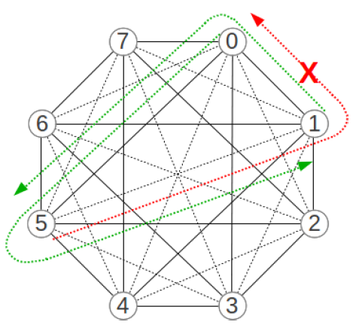
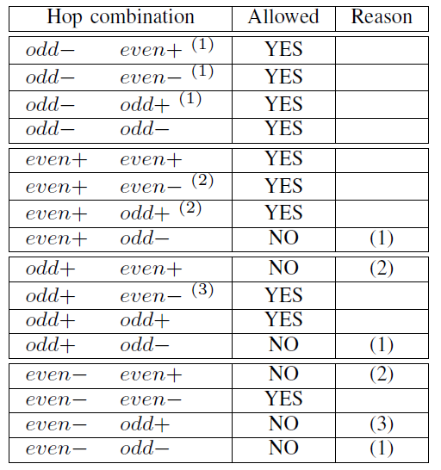
2 Dragonfly networks 2.3 RLM Restricted Local Misrouting - Path restriction
Implementation based on parity and sign of each link.
Parity of a link: even(odd) if both nodes have the same (different) parity
Sign: Positive + if destination index > source index
even-, odd-
Allowed 2-hop paths from 5 to 0: 5-2-0 and 5-4-0 (odd-, even-) 5-6-0 (odd+, even-)
[19] García et al, “Efficient Routing Mechanisms for Dragonfly networks”, ICPP’13

Slide 18
2.4. OLM: Opportunistic Local Misrouting Modified resource-class restriction
Oppportunistic Local Misrouting (OLM): Routing mechanism using 3/2 VCs with a modified distance-based deadlock avoidance mechanism:
Minimal routing and global misrouting → Increase VC index
Local misrouting (opportunistic) → Reuse or decrease VC index
Deadlock freedom: Local misrouting is opportunistic: if the packet cannot advance, there is always a safe “escape” path to the destination using increasing order of VCs: the one without local misrouting
Why it does work? The “safe path” always exists, due to the topology of the network
Decreasing the index on a local misrouting guarantees that a path with increasing order in the VC index exists, since all routers (but one) in a group have the same distance to the destination group.
[19] García et al, “Efficient Routing Mechanisms for Dragonfly networks”, ICPP’13

Slide 19
2.4. OLM: Opportunistic Local Misrouting Modified resource-class restriction
VC indexes: VC₁ – VC₂ – VC₃ – VC₄ – VC₅
Minimal routing
2
3
Interm. group
Destination group
1
VC₃
VC₄
VC₅
VC₄
Global misrouting
VC₁
VC₃
5
VC₃
3
4
1
2
VC₂
VC₂
OLM
VC₁
VC₂
4
5
2
3
1
1
1
VC₁
VC₁
Source group
[19] García et al, “Efficient Routing Mechanisms for Dragonfly networks”, ICPP’13

Slide 20
2. Dragonfly networks Deadlock avoidance mechanisms comparison chart
 | Piggy- backing[15] | OFAR [16] | PAR-6/2 [19] | RLM [19] | OLM [19]
Local misrouting
Congestion-prone (escape network) | NO | YES | NO | NO | NO
VCs in local ports (cost) | 3 | Any | 6 | 3 | 3
Routing freedom In local misrout. | None | Max. | Max | Just Enough | Max
Wormhole support
[15] Jiang, Kim, Dally. Indirect adaptive routing on large scale interconnection networks. ISCA '09.
[16] M. García et al, “On-the-fly adaptive routing in high-radix hierarchical networks,” ICPP’12.
[19] García et al, “Efficient Routing Mechanisms for Dragonfly networks”, ICPP’13

Slide 21
Index
Introduction
Direct interconnection network topologies: low radix
Deadlock avoidance mechanisms
Topologies proposed for high-radix networks
Dragonfly networks
Topology and routing
OFAR: Injection restriction
RLM: Path restriction
OLM: Modified Resource-class restriction
Evaluation results
Conclusions

Slide 22
3. Evaluation 3.1 Simulation parameters
Simulated network:
2.064 routers with 31 ports/router
129 groups of 16 routers each, 16x8=128 comp. nodes per group
16.512 servers in the system
FOGSim [20] used with a simple configuration:
Input-FIFO router model
Virtual cut-through switching
No speedup, single-cycle router
Synthetic traffic: uniform or worst-case patterns
Link latencies and queue sizes:
10 cycles in local links, 32 phits per VC
100 cycles in global links, 256 phits per VC
[20] FOGSim Simulator: https://code.google.com/p/fogsim/

Slide 23
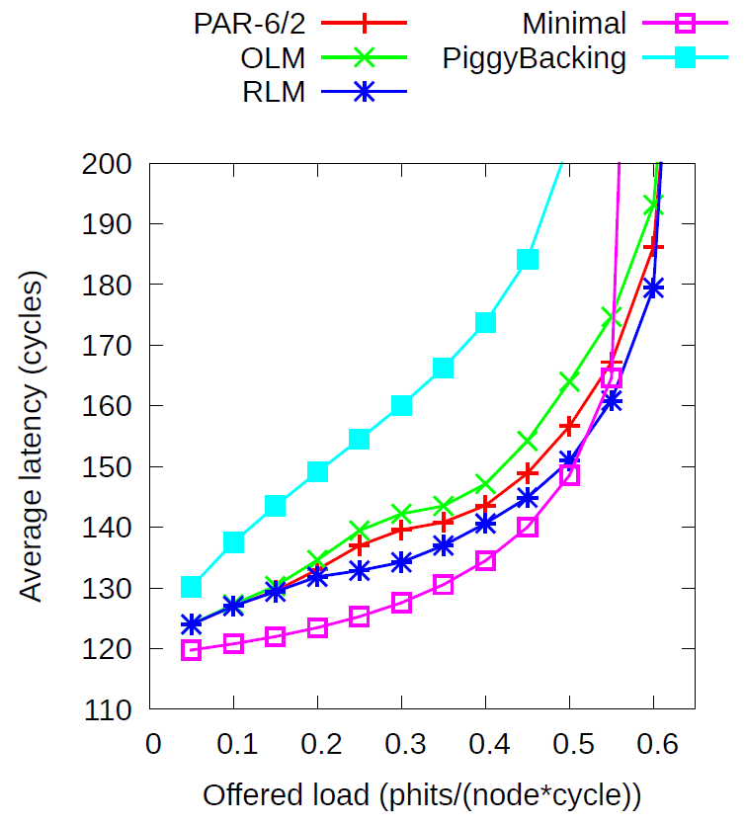
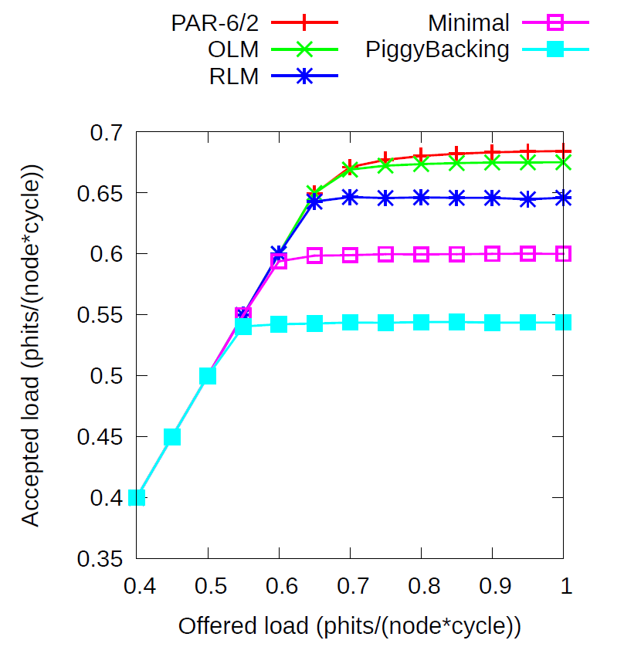
3. Evaluation 3.2. Latency and throughput
Performance – uniform traffic

Slide 24
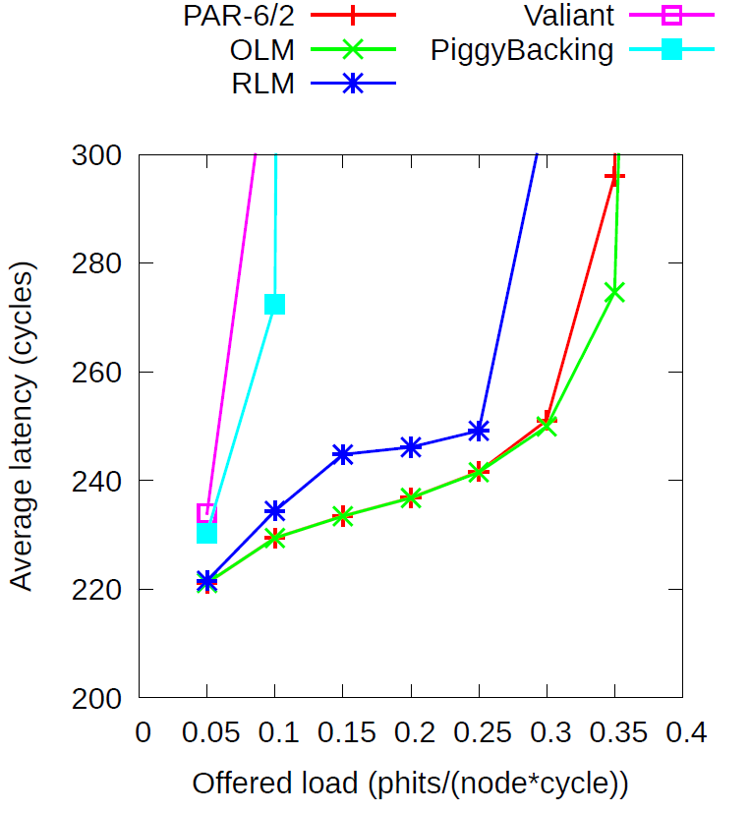
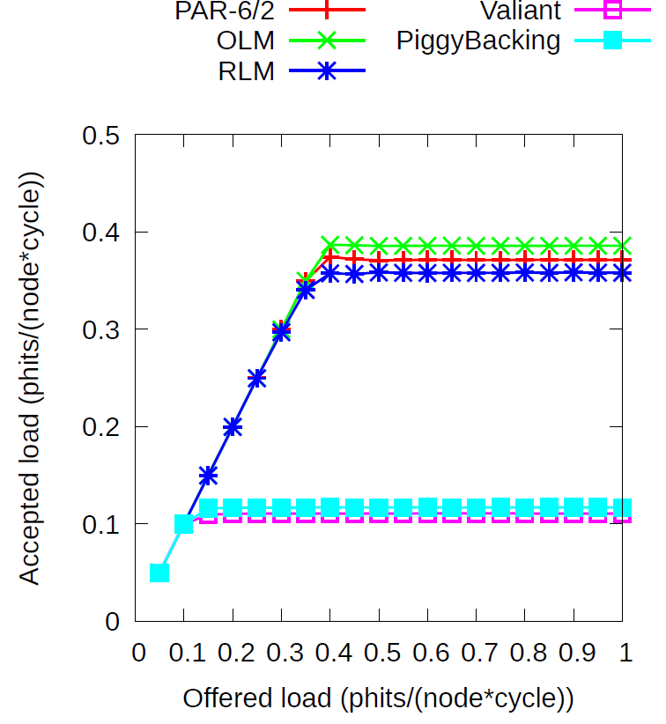
3. Evaluation 3.2. Latency and throughput
Performance – adversarial ADV+6 traffic

Slide 25
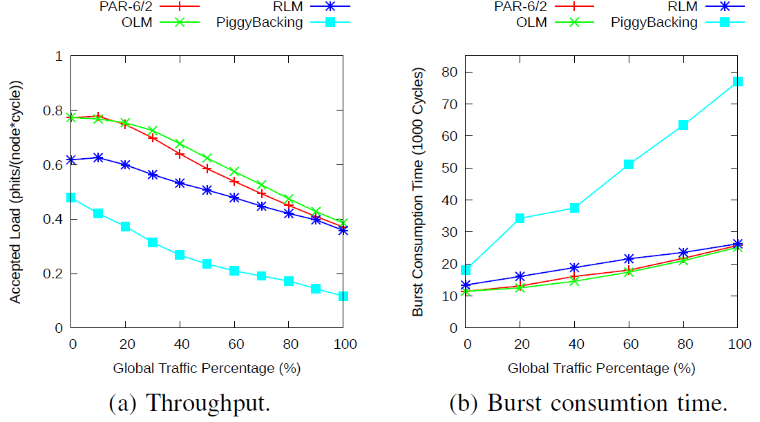
3. Evaluation 3.2. Variable local & global misrouting
Intra-group adversarial traffic
Inter-group adversarial traffic

Slide 26
Index
Introduction
Direct interconnection network topologies: low radix
Deadlock avoidance mechanisms
Topologies proposed for high-radix networks
Dragonfly networks
Topology and routing
OFAR: Injection restriction
RLM: Path restriction
OLM: Modified Resource-class restriction
Evaluation results
Conclusions

Slide 27
4. Conclusions
High-radix networks are cost and energy efficient
New opportunities & challenges for deadlock avoidance
Their low diameter make distance-based deadlock avoidance mechanism appealing
But misrouting & protocol deadlock quadruple implementation cost
We have explored alternative low-cost deadlock avoidance mechanisms based on:
Injection restriction: OFAR
Path restriction for local misrouting: RLM
Modified distance-based restriction for local misrouting: OLM
Opportunistic Local Misrouting is competitive with distance-based mechanisms at half the VCs
And RLM is the best option for wormhole networks
We continue exploring alternative solutions:
Deadlock avoidance mechanism completeley based on path restrictions (i.e., no VCs required) to be presented on Wednesday [21]
[21] Camarero, Vallejo & Beivide “Topological Characterization of Hamming and Dragonfly Networks and its Implications on Routing”. HiPEAC’15 (WEDNESDAY MORNING!)

Slide 28
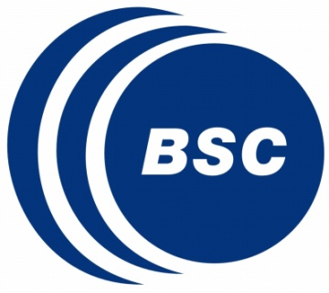
Acknowledgements
Most of our contributions presented here have been developed in the Computer Architecture group from the University of Cantabria, led by Prof. Ramón Beivide
Additional contributors to the results in this presentation include:
Ramón Beivide (UC)
Marina García (UC)
Pablo Fuentes (UC)
Miguel Odriozola (UC)
Cristóbal Camarero (UC)
Germán Rodríguez (IBM Research Zurich)
Cyriel Minkenberg (IBM Research Zurich)
Mateo Valero (UPC & BSC)
Jesús Labarta (UPC & BSC)

Slide 29
Sources & References
Dally & Towles, “Principles and Practices of Interconnection Networks”, MK 2003
Pinkston, “Deadlock Characterization and Resolution in Interconnection Networks. Marcel Dekker Ed. 2005
[1] Glass & Ni, “The turn model for adaptive routing”, ISCA’92
[2] Seo et al. “Near optimal worst-case throughput routing for two-dimensional mesh networks”, ISCA’05
[3] Gunther, “Prevention of deadlocks in packet-switched data transport systems,” Trans. Comm’81.
[4] Dally & Seitz, “The Torus Routing Chip”, J. Distributed Computing, 1986
[5] Carrión, et al, “A flow control mechanism to avoid message deadlock in k-ary n-cube networks," HiPC’97.
[6] Puente, Izu, Beivide et al, “The Adaptive Bubble Router”, J. PDC’01.
[7] Kim, Dally, Towles & Gupta, “Microarchitecture of a high-radix router,” ISCA’05
[8] Kim, Dally & Abts, “Flattened butterfly: A cost-efficient topology for high-radix networks”, ISCA’07
[9] Ho Ahn et al, “HyperX: topology, routing, and packaging of efficient large-scale networks”, SC’09
[10] Kim, Dally, Scott, Abts. Technology-Driven, Highly-Scalable Dragonfly Topology. ISCA '08
[11] Arimilli et al, “The PERCS high-performance Interconnect”, HOTI’10
[12] Faanes et al, “Cray Cascade: a Scalable HPC System based on a Dragonfly Network,” SC12,
[13] Besta &Hoefler, “Slim Fly: A Cost Effective Low-Diameter Network Topology”, SC’14
[14] Valiant, “A scheme for fast parallel communication," SIAM journal on computing, vol. 11, p. 350, 1982.
[15] Jiang, Kim & Dally. “Indirect adaptive routing on large scale interconnection networks.” ISCA '09.
[16] García et al, et al, “On-the-fly adaptive routing in high-radix hierarchical networks,” ICPP’12
[17] García et al, “OFAR-CM: Efficient Dragonfly Networks with Simple Congestion Management”, HOTI’13
[18] García et al, “On-the-Fly Adaptive Routing for dragonfly interconnection networks”, J. Supercomputing’14
[19] García et al, “Efficient Routing Mechanisms for Dragonfly networks”, ICPP’13
[20] FOGSim Simulator: https://code.google.com/p/fogsim/
[21] Camarero, Vallejo & Beivide “ Topologycal characterization of Hamming and Dragonflies and its implications on routing”. HiPEAC’15 (WEDNESDAY MORNING!)

Slide 30
Low-cost deadlock avoidance in direct interconnection networks
Enrique Vallejo
http://personales.unican.es/vallejoe/
Invited talk
9th International Workshop on
Interconnection Network Architecture:
On-Chip, Multi-Chip (INA-OCMC) 2015

